Slide 1
AI Platform
Fully managed, end-to-end platform
for data science and machine learning

Slide 2
benefits
For every skill level. Whether it's point-and-click data science using AutoML or advanced model optimization, AI Platform helps all users take their projects from ideation to deployment, quickly and seamlessly.
MLOps, simplified. Machine learning doesn’t stop at deployment. AI Platform makes it easy for developers, data scientists, and data engineers to streamline and scale their ML workflows.
Best of Google's AI. Take advantage of Google’s expertise in AI by infusing our cutting-edge technologies into your applications via tools on AI Platform like TPUs and TensorFlow.

Slide 3
End-to-end machine learning life cycle
Prepare and store your datasets with BigQuery and Cloud Storage, then use the built-in Data Labeling Service to label your training data for classification, object detection, entity extraction, and other objectives for image, video, tabular, and text data.
Build best-in-class ML models without writing any code with AutoML's easy-to-use UI, or using your own code written in Notebooks, a managed Jupyter Notebook service. Use the latest open-source deep learning frameworks on Deep Learning VM Image or Deep Learning Containers. Then train your models with our fully managed Training service.
Validate your model with AI Explanations and What-If Tool, which help you understand your model's outputs, verify model behavior, identify bias, and find ways to improve your model and training data. Take model tuning a step further using Vizier, a black-box optimization service, to tune hyperparameters and optimize your model’s performance.

Slide 4
End-to-end machine learning life cycle
Deploy your models at scale to get predictions in the cloud with Prediction, which hosts your model for online and batch prediction requests. You can also use AutoML Vision Edge to deploy your models at the edge and trigger real-time actions based on local data. TensorFlow Enterprise offers enterprise-grade support for TensorFlow instances.
Manage your models, experiments, and end-to-end workflows with Pipelines by applying MLOps best practices with robust, repeatable pipelines. Continuous evaluation helps you monitor your models' performance, and provides continual feedback over time.

Slide 5
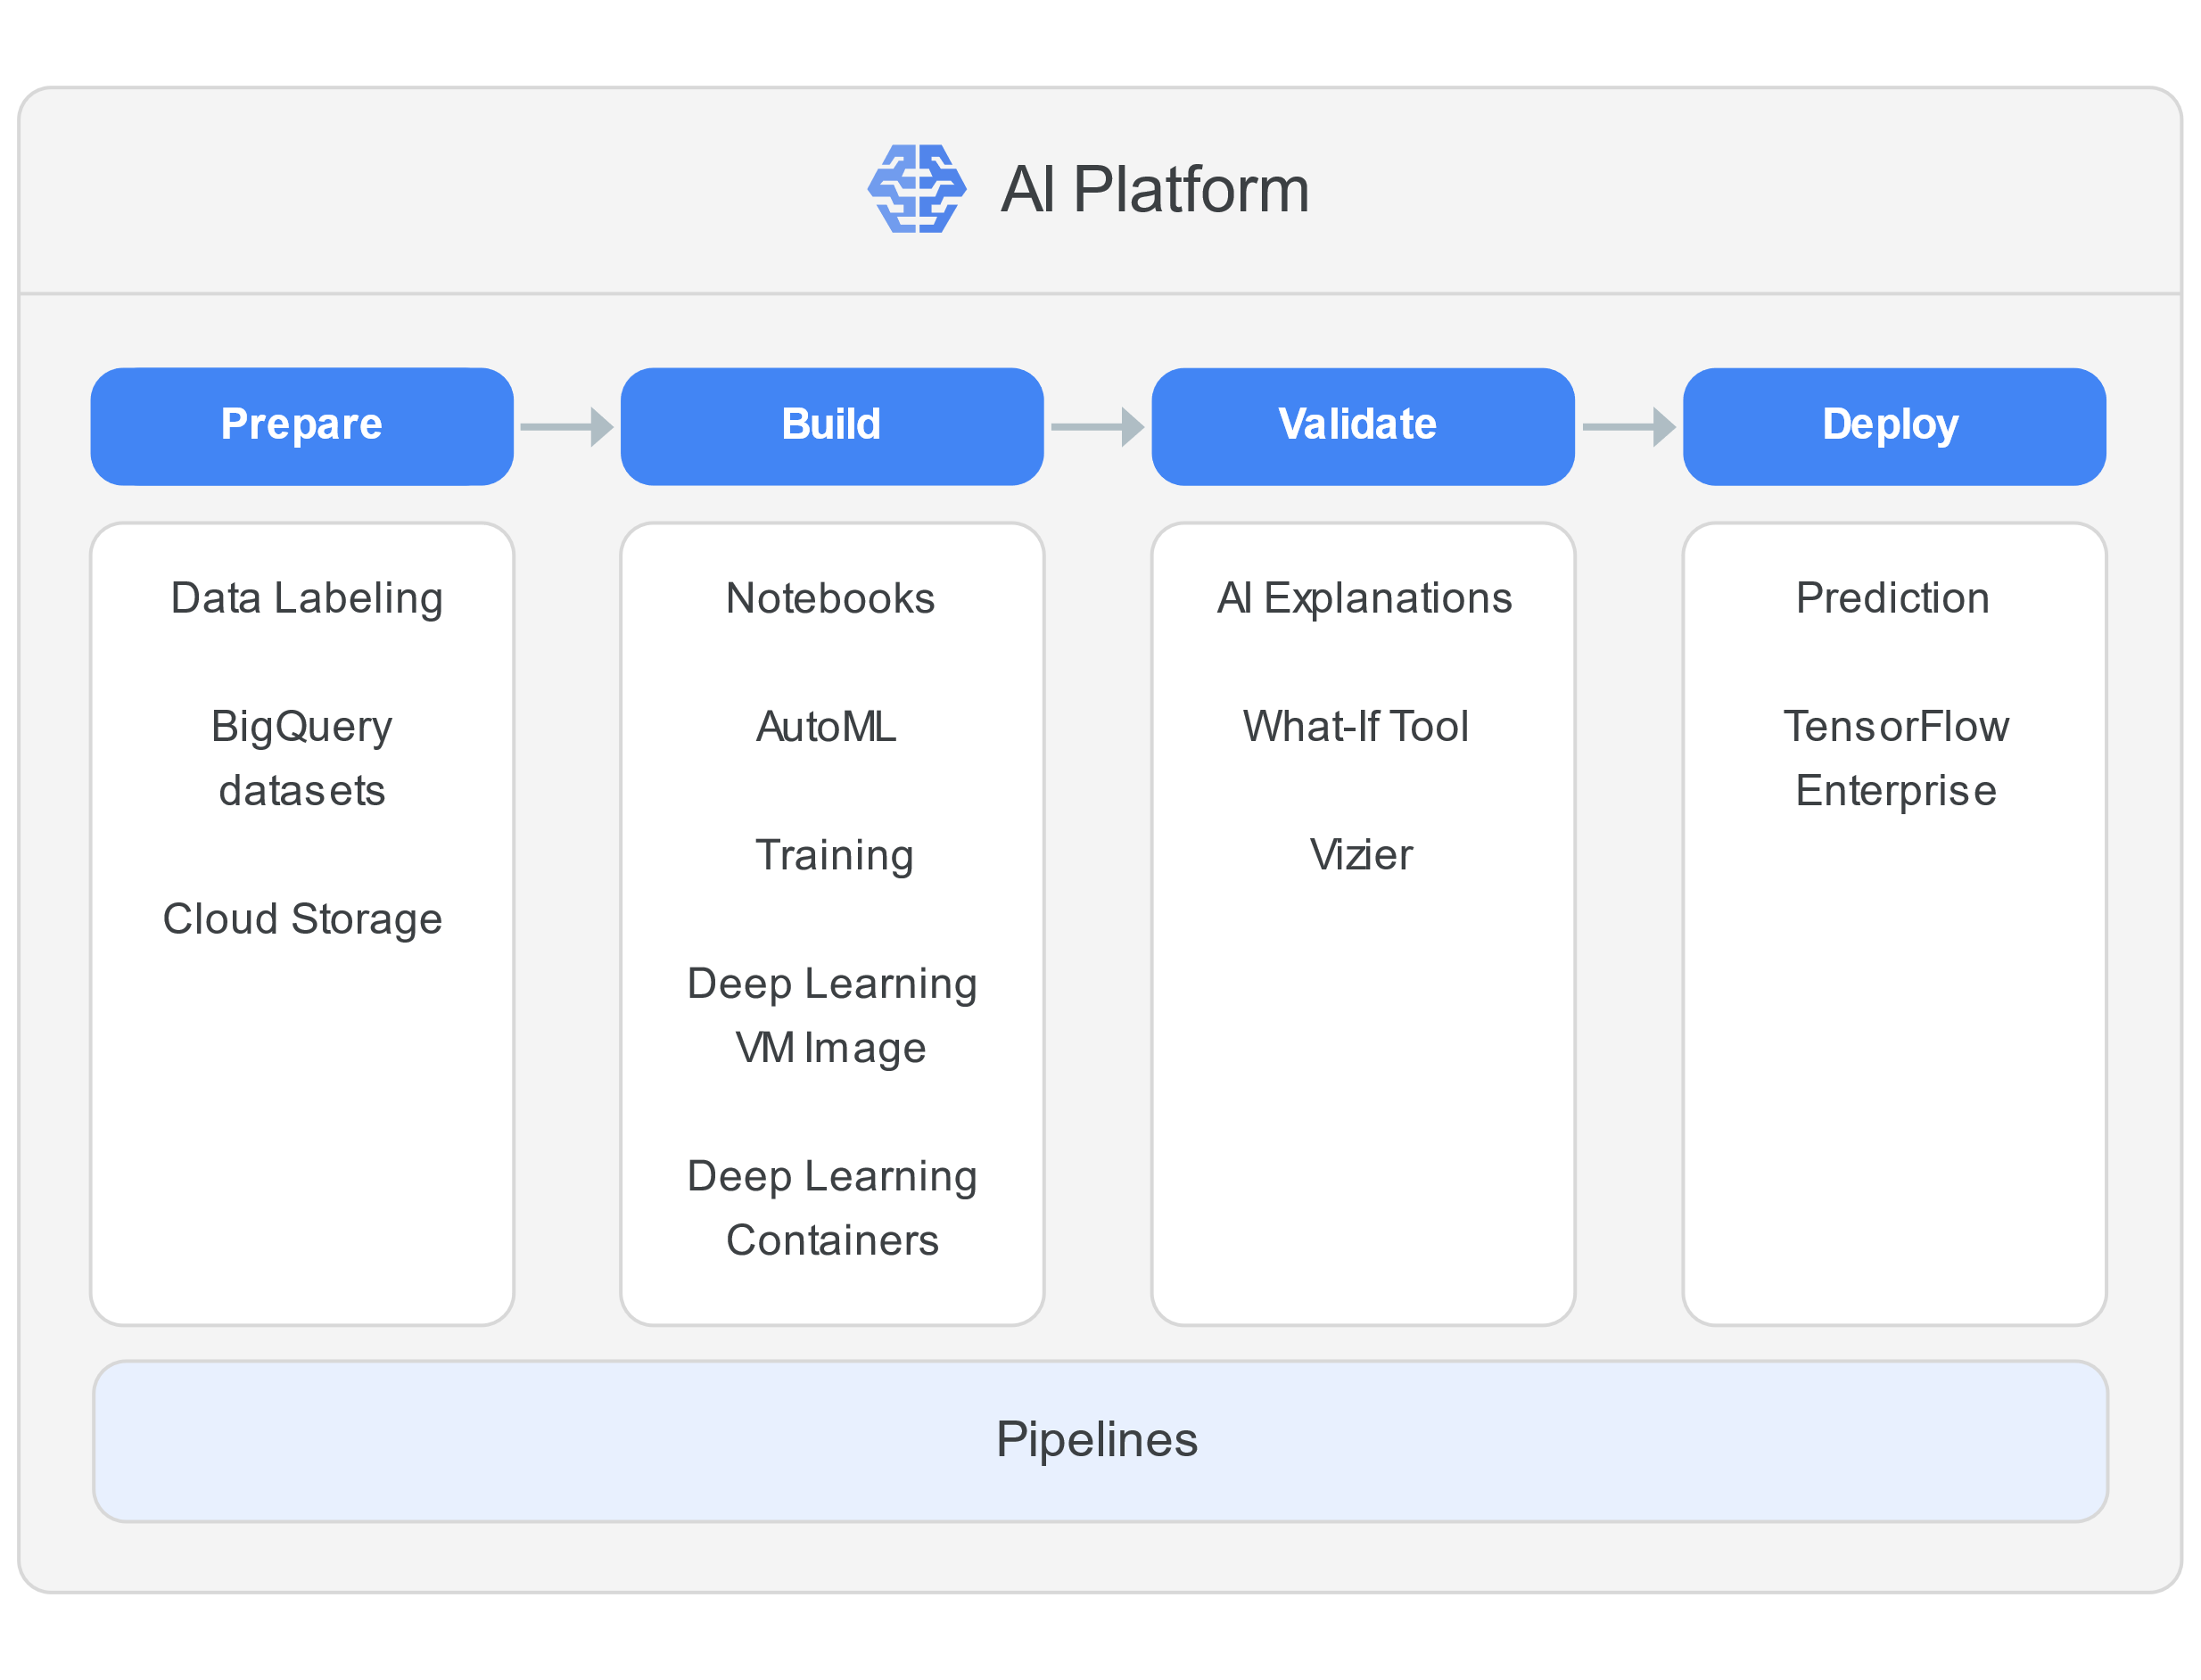
End-to-end machine learning life cycle

Slide 6
All your AI tools in one platform
AI Explanations
Data Labeling Service
AutoML
Deep Learning Containers
Deep Learning VM Image
Notebooks
Continuous evaluation
Neural Architecture Search
Pipelines
Prediction
Training
What-If Tool
Vizier
TensorFlow Enterprise

Slide 7
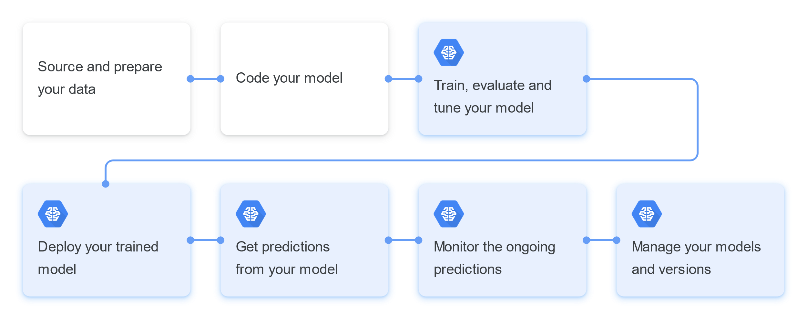
ML workflow

Slide 8
Components of AI Platform
Training service. The AI Platform training service allows you to train models using a wide range of different customization options.
Prediction service. The AI Platform prediction service allows you to serve predictions based on a trained model, whether or not the model was trained on AI Platform.
Notebooks. AI Platform Notebooks enables you to create and manage virtual machine (VM) instances that are pre-packaged with JupyterLab.
Data labeling service. AI Platform Data Labeling Service (beta) lets you request human labeling for a dataset that you plan to use to train a custom machine learning model.
Deep learning VM image. AI Platform Deep Learning VM Image lets you choose from a set of Debian 9-based Compute Engine virtual machine images optimized for data science and machine learning tasks.

Slide 9
Tools to interact with AI Platform
Google Cloud Console. You can deploy models to the cloud and manage your models, versions, and jobs on the Cloud Console. This option gives you a user interface for working with your machine learning resources. As part of Google Cloud, your AI Platform resources are connected to useful tools like Cloud Logging and Cloud Monitoring.
The gcloud command-line tool. You can manage your models and versions, submit jobs, and accomplish other AI Platform tasks at the command line with the gcloud ai-platform command-line tool.
REST API. The AI Platform REST API provides RESTful services for managing jobs, models, and versions, and for making predictions with hosted models on Google Cloud. You can use the Google APIs Client Library for Python to access the APIs.

Slide 10
Simple project
classification using builted-in algorithm

Slide 11

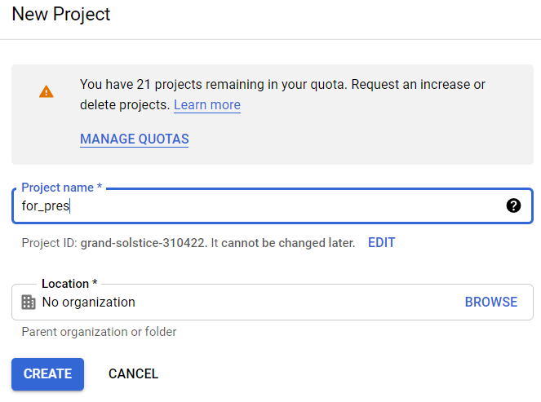
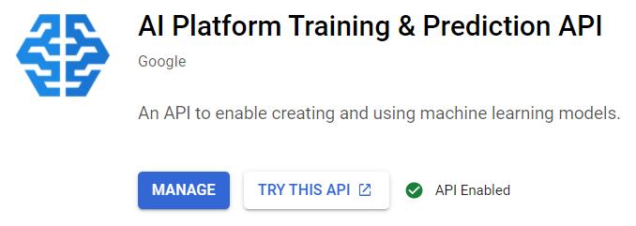
Create new project and enable api

Slide 12
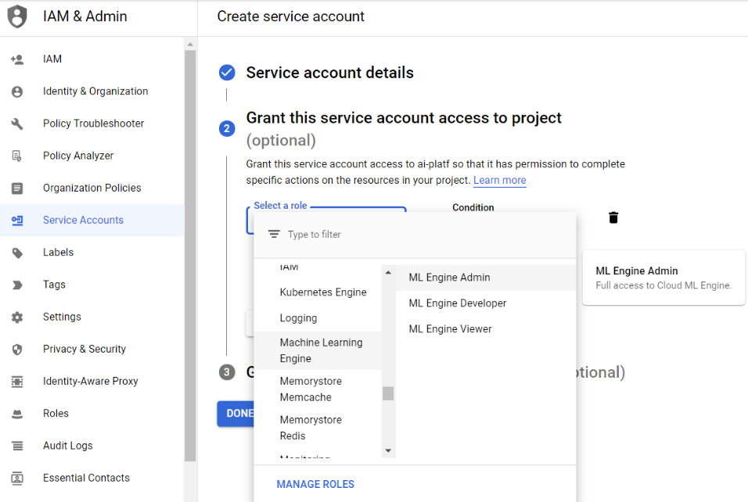
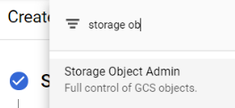
Create service account
Select ML Engine Admin and Storage Object Admin roles

Slide 13
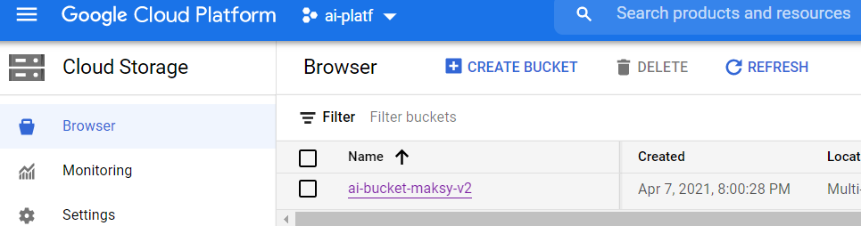
Create bucket
And load train and test data there

Slide 14
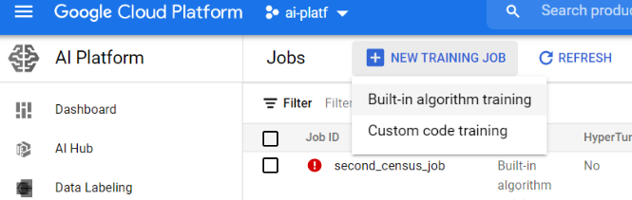
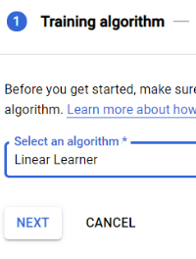
Create new job with built-in algorithm

Slide 15
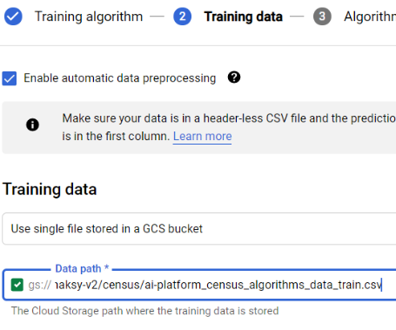
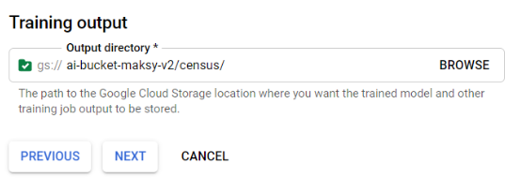
Chose train and test data

Slide 16
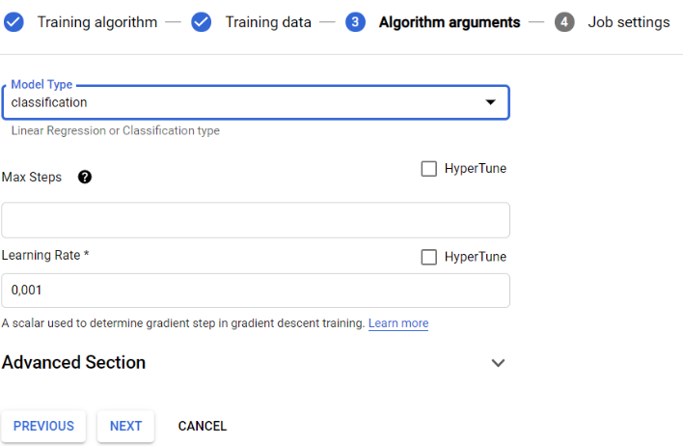
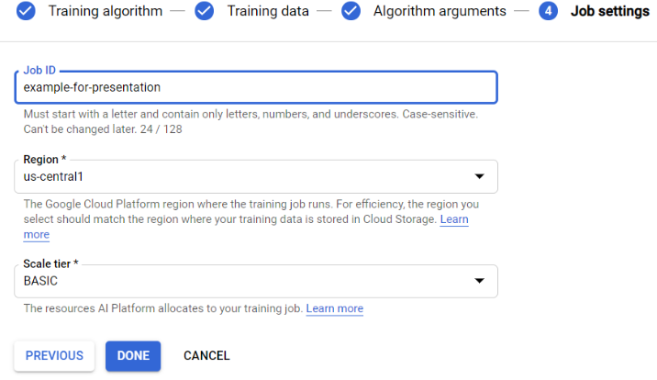
Configure other arguments

Slide 17
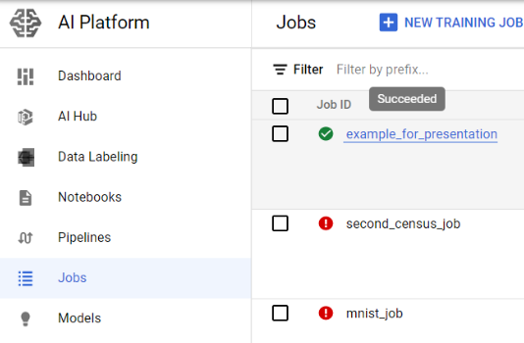
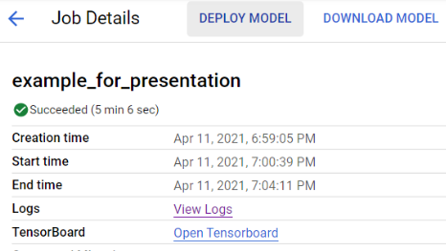
After successful training
Click on job name
and deploy model

Slide 18
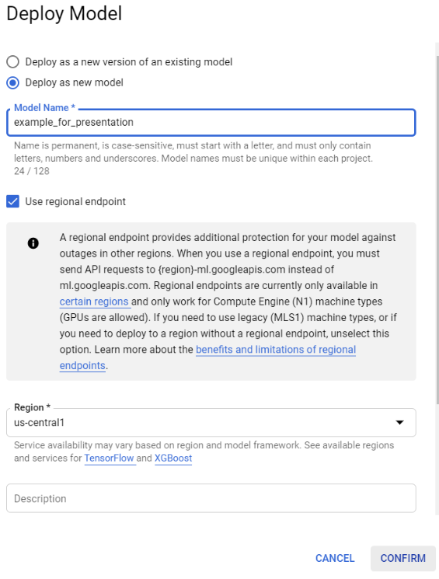
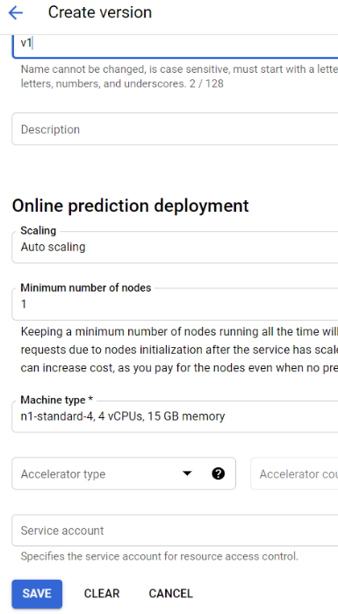
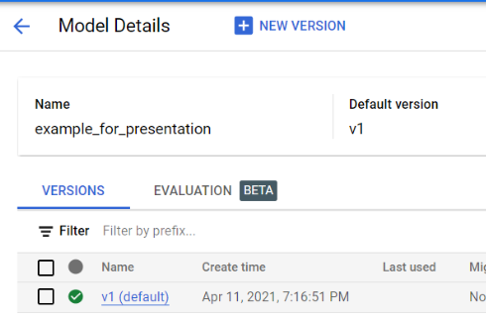
Deploy model and crate version

Slide 19
Congratulation!
Now you can send requests and get predictions. Example: https://github.com/Gurdel/University-projects-and-labs/tree/main/Parallel%20programming/presentation%20AI%20Platform
AI Platform overview and documentation:
https://cloud.google.com/ai-platform
THANKS FOR ATENTION

